Slide 1

Detailed project report HR Analytics - Absenteeism
By
Suman Das

Slide 2
Objective:
Find out the average absent hour by employees irrespective of business unit, division, department and job role. This analysis will also help to determine the reason of absence by the employees. It may be due to their age or average service length.
Benefits:
Analysis of absence among business unit, division, department.
Analysis of absence based on gender.
Analysis of absence based on job role.
Finding reasons of absence.

Slide 3
Data Sharing Agreement :
Sample file name (MFGEmployees4)
Number of Columns (13)
Column names (Employee Number, Surname, Given Name, Gender, City, Job Title, Department Name, Store Location, Division, Age, Length service, Absent Hours, Business Unit)
Column data type
Numerical datatype - Employee Number, Age, Length service, Absent Hours.
Text datatype - Surname, Given Name, Gender, Job Title, Department Name, Store location, Division, Business Unit.
Geographical datatype: City, Store Location.

Slide 4
Architecture
Start
Data gathering
Raw data validation
Data transformation
Data preprocessing
Data visualization
Dashboard reporting

Slide 5
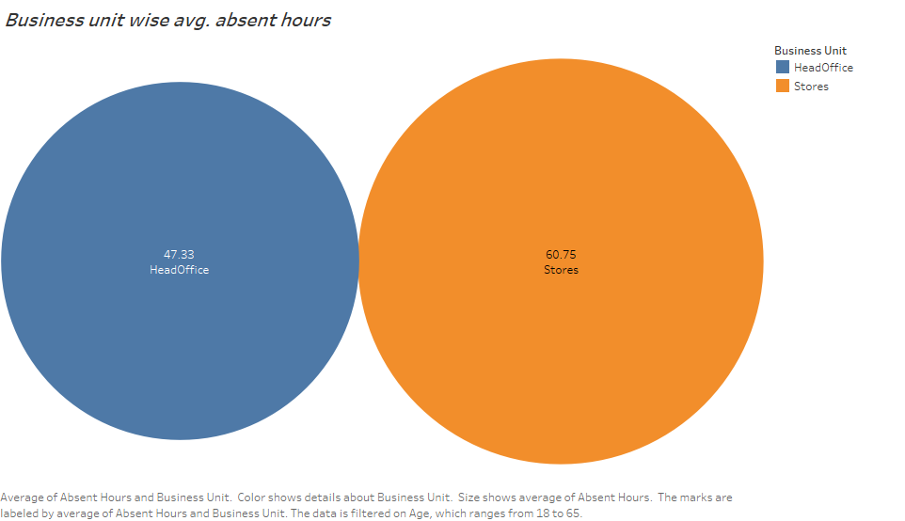
Business unit wise avg. absent hours

Slide 6
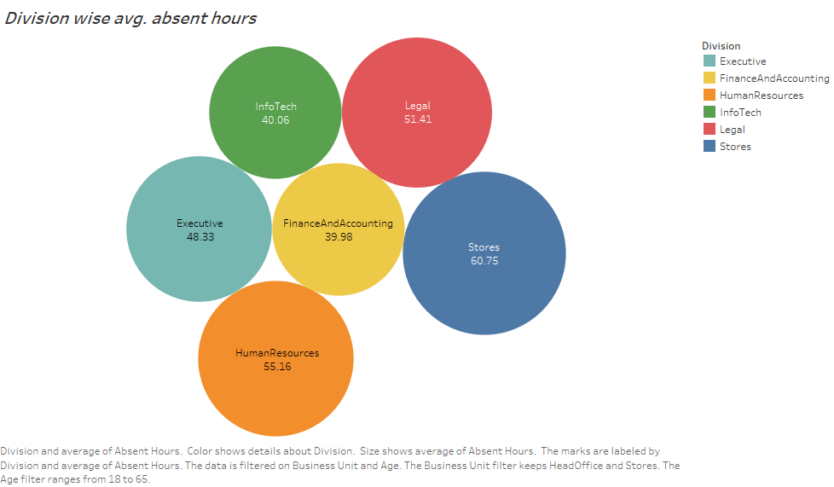
Division wise avg. absent hours

Slide 7
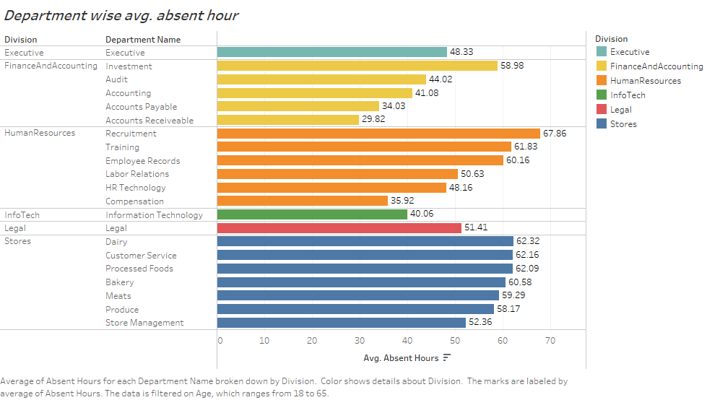
Department wise avg. absent hour

Slide 8
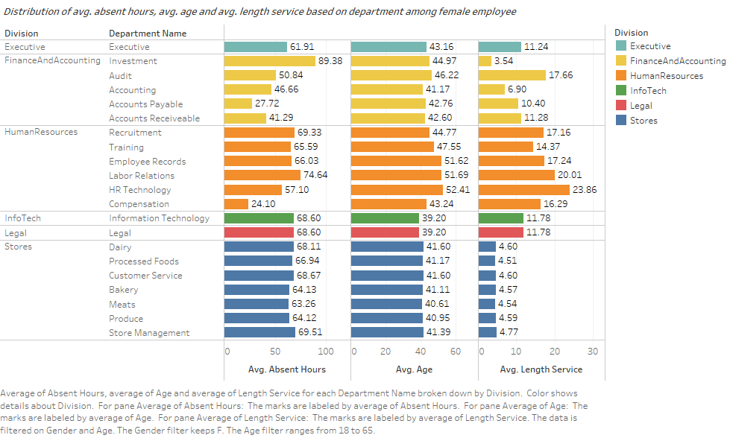
Distribution of avg. absent hours, avg. age and avg. length service based on department among female employee

Slide 9
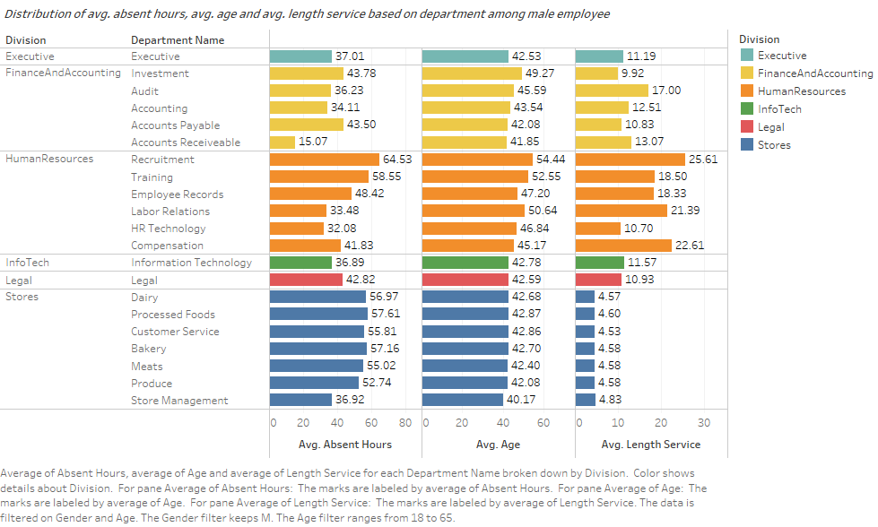
Distribution of avg. absent hours, avg. age and avg. length service based on department among male employee

Slide 10
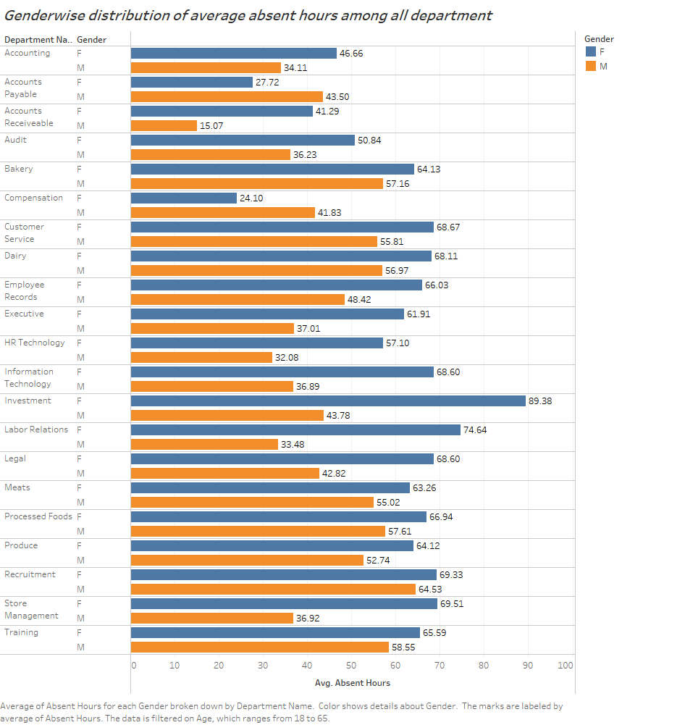
Gender wise distribution of average absent hours among all department

Slide 11
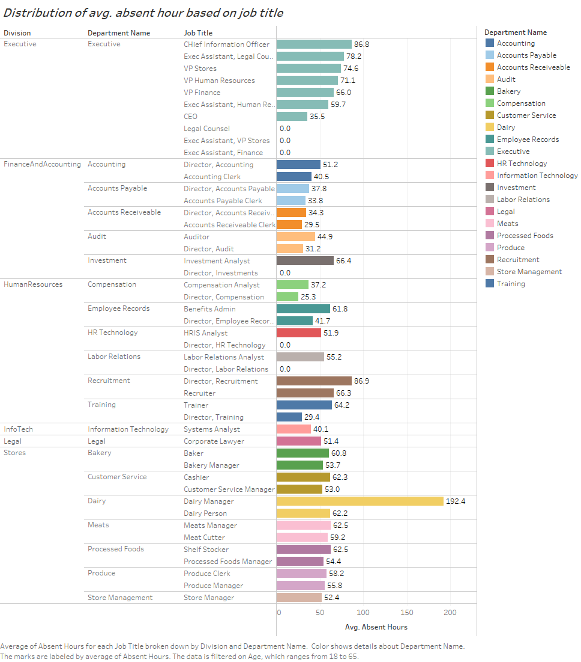
Distribution of avg. absent hour based on job title

Slide 12
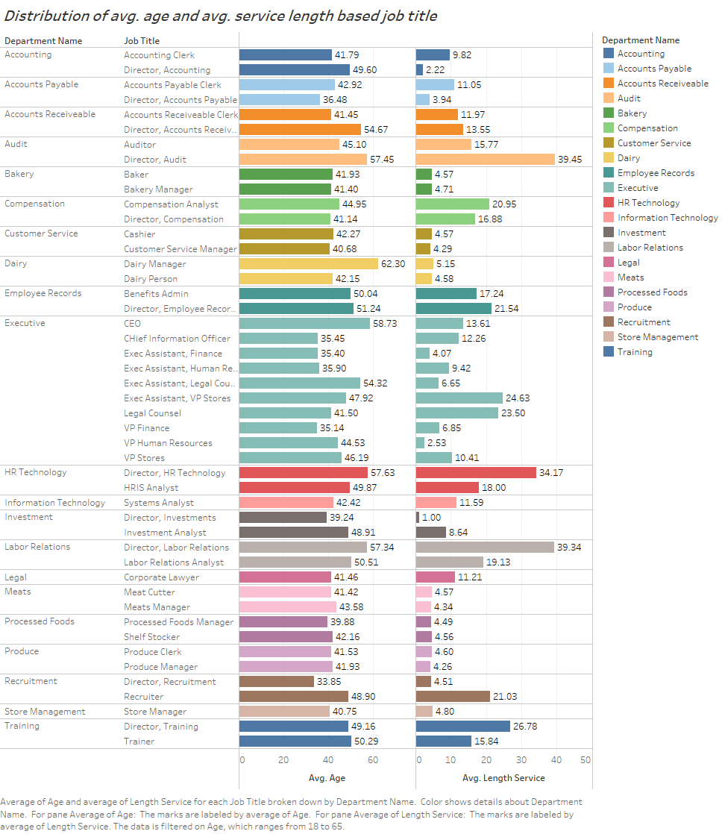
Distribution of avg. age and avg. service length-based job title

